Slide 1
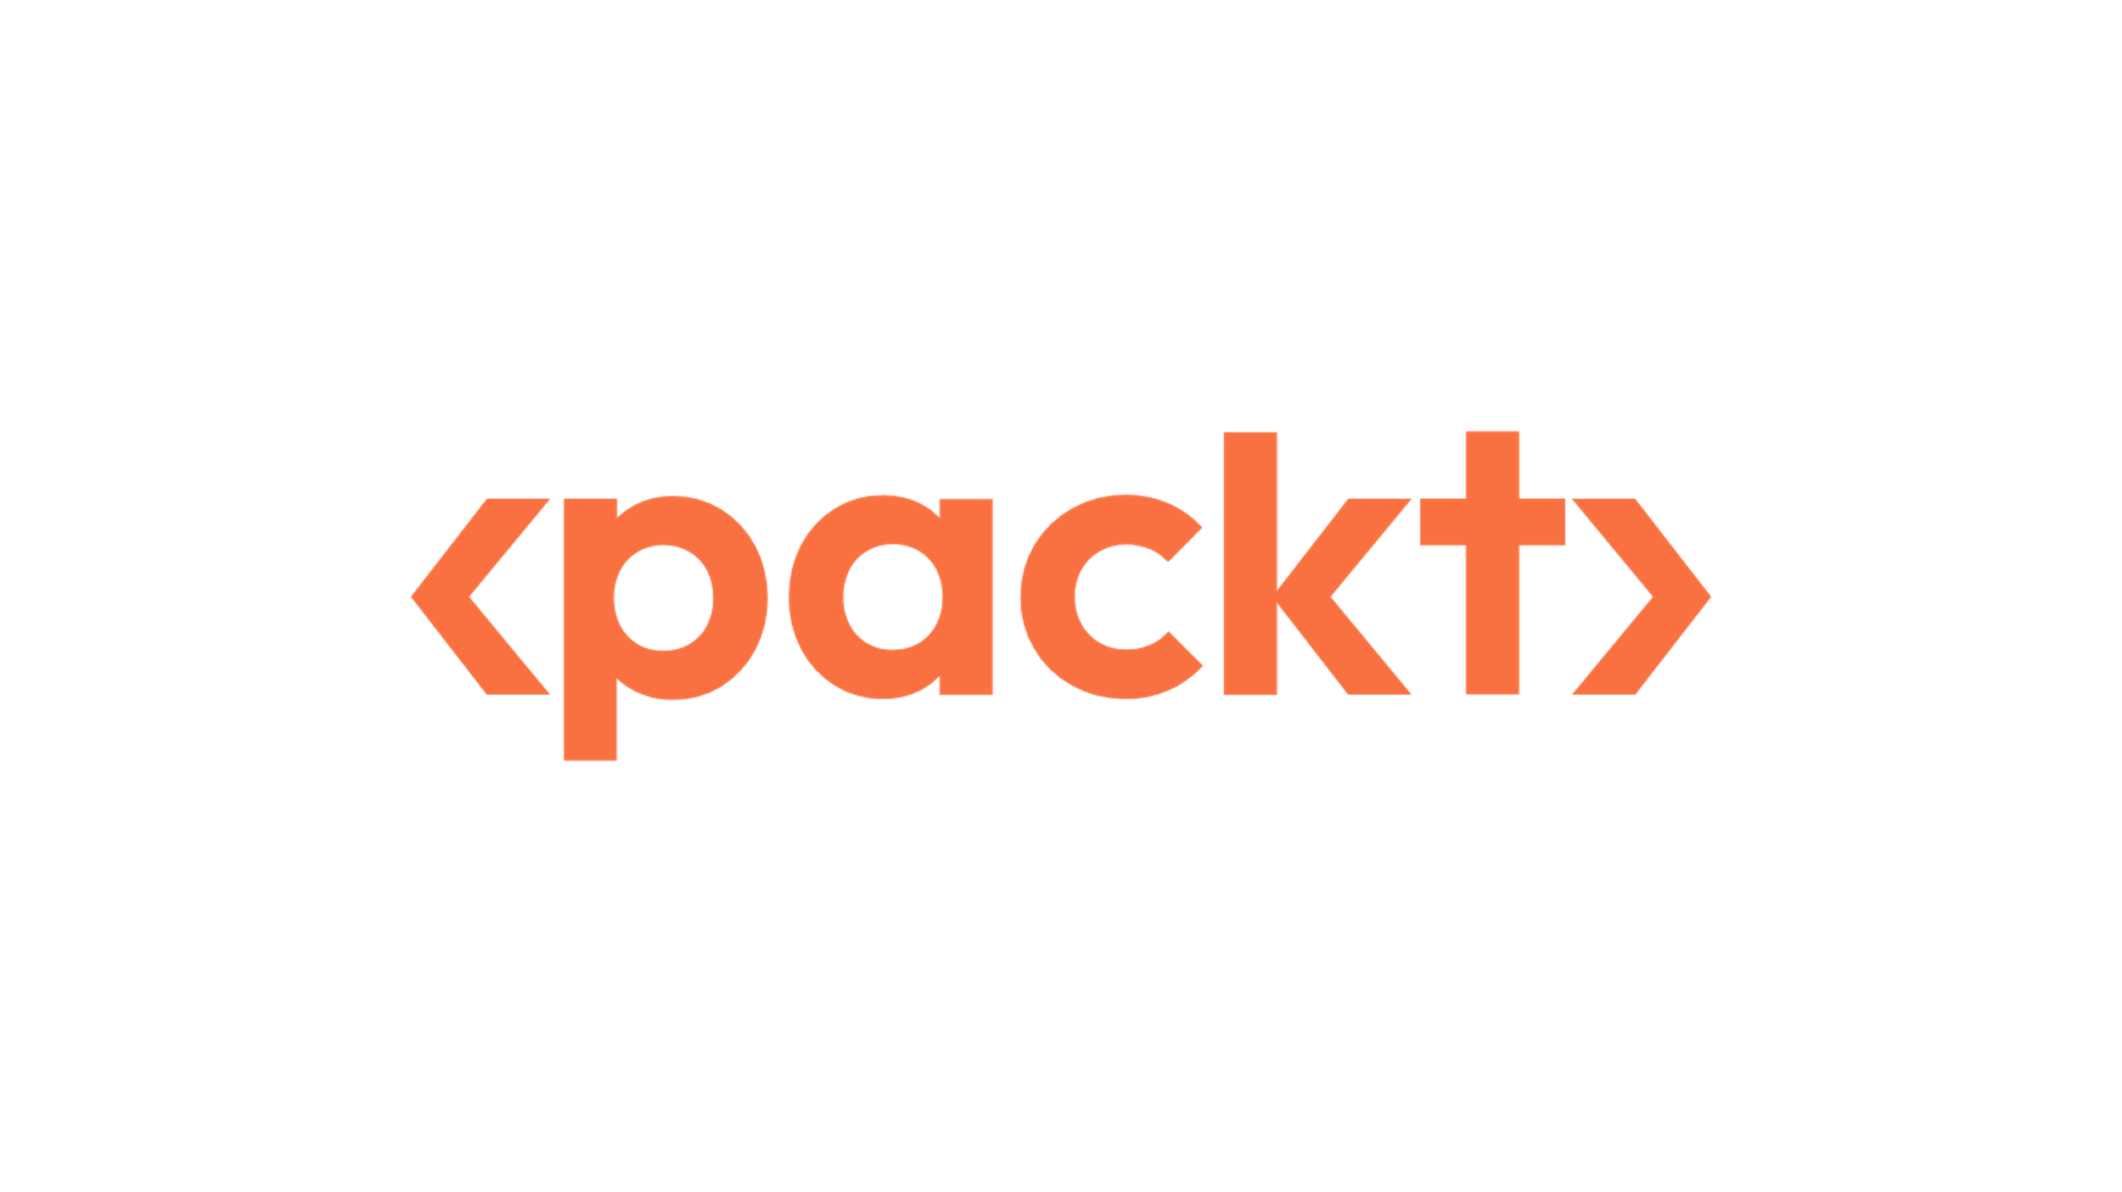


Starting Now
Autonomous Agents: Hype vs. Reality
Today's session explores the promise—and limitations—of autonomous agents. We'll dive into their architectures, evaluate their real-world utility, and walk through patterns and tools used to orchestrate workflow automation using these intelligent systems.
Imran Ahmad
Data Scientist | Author

Slide 2
Agenda
01
Framing Autonomous Agents
02
Hype: What's Promised
03
Reality: What's Deliverable
04
Key Tools: LangChain, CrewAI, LangGraph
05
Engineering Agent Systems
06
Walkthrough: Document Q&A Workflow
07
Q&A + Final Thoughts

Slide 3
From Scripts to Agents
Traditional automation = brittle workflows
Modern agents = goal-driven, tool-using
Autonomy = planning + adaptation
Use of memory and state
Designed to respond, reason, act
>
Pg: 1
Notes:
Speaker Notes: Think of agents as "workers" who observe, plan, and act using tools. This is not about conversation—it's about capabilities.

Slide 4
What Is an Autonomous Agent?
Goal-driven and adaptive
Continuously perceives its environment
Processes and contextualizes inputs
Plans actions using internal memory
Learns and evolves through experience
>
Pg: 1
Notes:
Speaker Notes: These agents don't just act—they think, learn, and refine. Cognitive agents reflect a shift toward systems that reason over goals and context, improving their decision-making over time.

Slide 5
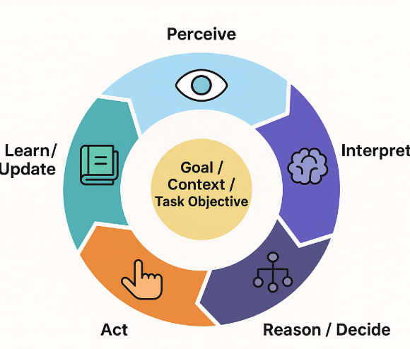
The Cognitive Loop
Cognitive loop—a continuous cycle of perception, reasoning, planning, action, and learning
>
Pg: 1

Slide 6
The Agent Loop in Practice
Perception → Context → Plan → Act → Learn → repeat
Based on Franklin & Graesser's agent model
Supports adaptation in dynamic environments
Drives goal refinement
>
Pg: 1
Notes:
The cognitive loop ties together the lifecycle of intelligent behavior. Learning feeds back into perception and planning, enabling persistent improvement—key to long-term agent autonomy.

Slide 7
Hype – What We Hear
"Agents will replace developers“
"Just give it a goal and go!“
"One agent can do everything“
"Fully autonomous apps today"
>
Pg: 1

Slide 8
Reality – What Actually Works
Agents need orchestration
Tool use must be scoped
Planning often fails without grounding
Memory is brittle or shallow
Hallucination remains unsolved
>
Pg: 1
Notes:
Autonomous? Kind of. But it's more accurate to think of today's agents as useful components within a workflow, not total replacements.

Slide 9
Key Challenges
Prompt fragility
API/tool misalignment
State inconsistency
Debugging multi-agent paths
Regulatory and privacy risks
>
Pg: 1
Notes:
Most failures are not model failures—they're engineering failures. Without orchestration, memory, and oversight, agent systems collapse quickly.

Slide 10
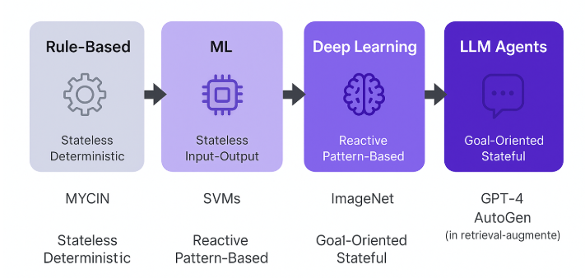
Evolution of AI Agent Technologies
>
Pg: 1

Slide 11
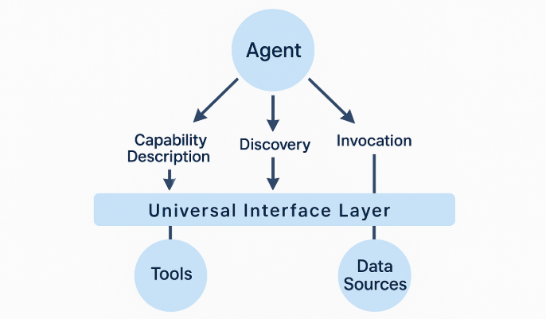
The Modern Cognitive Pipeline (MCP):
Layered agent structure
Modular stages: perceive, plan, act
Memory + learning as feedback loop
Aligns with real agent frameworks
>
Pg: 1
Notes:
This evolutionary trajectory highlights fundamental architectural distinctions between conventional AI applications and truly autonomous agent systems. MCP gives us a blueprint for building intelligent agents where each stage can be implemented with specialized tools.

Slide 12
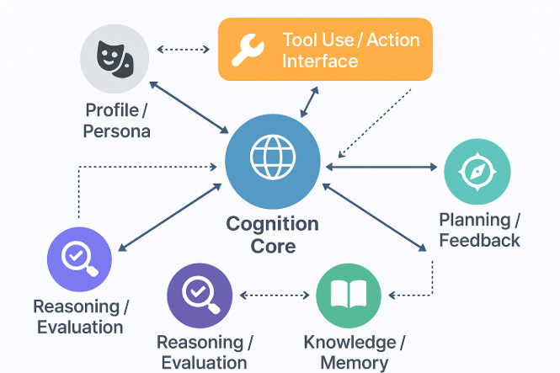
Agent Communication Architecture
Agent-to-System (A2S) Interaction Model:
Integration Layer: Interface to enterprise systems (ERP, CRM, APIs)
Autonomy Envelope: Boundary of independent agent control
Governance Layer: HITL, logging, compliance guards
Feedback Interface: For monitoring and escalation
>
Pg: 1
Notes:
The A2S model defines how agents integrate responsibly into larger systems. It helps balance autonomy with operational safety—critical for regulated industries and high-risk domains.

Slide 13
Framework – LangChain
Tool-calling and planning
ReAct and planner-executor loops
Agent types: OpenAIFunctionAgent, MultiActionAgent
Tools: APIs, databases, custom functions
>
Pg: 1
Notes:
LangChain is often the first stop for building tool-using agents. It offers structured primitives for planning and action execution.

Slide 14
Framework – CrewAI
Role-driven team structure
Think: team of experts working in sequence
Emphasizes specialization and memory
Each agent has a persona and task
>
Pg: 1
Notes:
CrewAI mimics human teams. It helps break down complex workflows into roles—planner, executor, verifier—each handled by an agent. CrewAI focuses on collaboration.

Slide 15
Use Case – Document Q&A Agent
Agents: Document Extractor, Case Validator, Compliance Watcher
Tools: OCR (for PDFs), Vector Database (Pinecone/ChromaDB), Public Data API, CrewAI, LangGraph, Rule Engines
Outcome: Improved throughput and transparency
Frameworks: LangChain + LangGraph
>
Pg: 1

Slide 16
Use Case – Code Workflow Assistant
Agents: Code Reviewer, Test Generator, CI/CD Runner
Tools: GitHub APIs, Linter, Code Formatter, CrewAI, LangGraph
Outcome: 50% faster PR cycles
Used in CI/CD pipelines
>
Pg: 1

Slide 17
Use Case – Human-in-the-Loop Support
Workflow: Agent proposes → Human approves
Adds reliability and compliance
Ideal for government, finance, healthcare
>
Pg: 1
Notes:
Trust is built through human oversight. HITL workflows remain a key pattern for mission-critical applications. For government services, the A2S model helps ensure audits, compliance, and oversight.

Slide 18
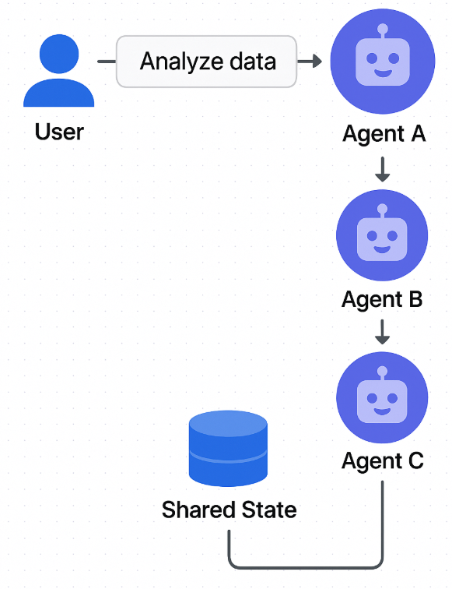
Multi-Agent System Architecture
Tool-Chaining in Practice:
Sequence of tool calls based on plan
Requires memory + retry logic
Example: Search → Retrieve → Summarize → Email
>
Pg: 1
Notes:
A chain of tools can simulate a workflow—but it needs planning and fallback logic. This is where agents shine beyond simple scripts. Multi-agent systems distribute cognitive responsibility across specialized agents.

Slide 19
Architecting for Reliability
Plan → Execute → Observe → Retry loop
Guardrails: prompt checks, schema validation
Logging + observability
External tools: HoneyHive, PromptLayer
>
Pg: 1
Notes:
Reliable agents need guardrails—like schema checks and retries—especially when they're touching APIs or customer data. Designing agents responsibly means embedding controls, auditability, and legal alignment from the start.

Slide 20
Memory Architectures
Short-term: in-task state
Long-term: vector stores (FAISS, Pinecone)
Episodic: history per user/session
Challenges: freshness, retrieval precision
>
Pg: 1
Notes:
Memory = power. It enables personalized and context-aware behavior—but must be managed carefully. Vector stores are used for memory.

Slide 21
Engineering Patterns
Planner + Tool Executor
Team-based (CrewAI)
Graph-based (LangGraph)
Prompt chaining + tool routing
>
Pg: 1
Notes:
These are not mutually exclusive. You can layer patterns—e.g., use LangChain for tool use, LangGraph for flow, CrewAI for roles. These frameworks embody the MCP and A2S designs.

Slide 22
Building Your First Agent
Pick a clear task (e.g., doc Q&A)
Choose a framework
Define tools & memory
Add logging & retries
Keep scope narrow
>
Pg: 1
Notes:
Start small. Scope is everything. A useful agent solves one repeatable task well before being generalized.

Slide 23
Evaluating Agent Systems
Task success rate
Tool call accuracy
Latency and retries
User feedback loop
>
Pg: 1
Notes:
Success isn't just about whether the model worked—it's whether the system worked: tools, memory, logic, and user interface.

Slide 24
Ethics, Governance, and Safety
HITL and bounded autonomy
Memory: short-term vs. episodic vs. long-term
Observability, logging, and rollback
GDPR, HIPAA: compliance-first architecture
>
Pg: 1
Notes:
Ethics isn't optional—it's structural. Designing agents responsibly means embedding controls, auditability, and legal alignment from the start.

Slide 25
The Future of Agents
Self-reflective agents (feedback-driven loop updates)
Cross-agent cognition & shared goals
Agent-as-a-Service (A2S) as a deployment model
Cognitive middleware across domains
>
Pg: 1
Notes:
Autonomous agents will evolve into intelligent networks. Teams of agents will self-organize, reflect on outcomes, and serve as elastic compute workers across verticals.

Slide 26
Key Takeaways
Autonomous ≠ fully independent
Planning, memory, and tools matter
Real value lies in orchestration
Most agents need scaffolding and oversight
>
Pg: 1
Notes:
Today's agents are more like interns than experts. With guidance and boundaries, they offer real productivity—but not magic.

Slide 27

Thank You

